Slide 1
Unit 1
Introduction to Software Testing
Prepared By,
Mr. Sunil H. Sangale

Slide 2
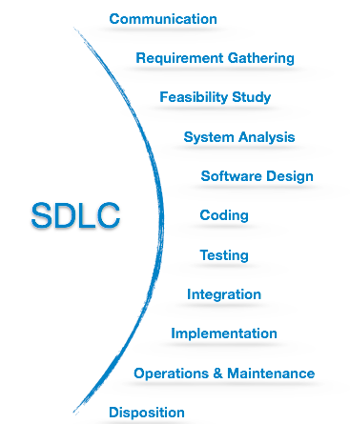
SDLC Activities
SDLC provides a series of steps to be followed to design and develop a software product efficiently.
SDLC framework includes the following steps:

Slide 3
SDLC Phases.
1. Communication
This is the first step where the user initiates the request for a desired software product. He contacts the service provider and tries to negotiate the terms. He submits his request to the service providing organization in writing.

Slide 4
2. Requirement Gathering
This step onwards the software development team works to carry on the project. The team holds discussions with various stakeholders from problem domain and tries to bring out as much information as possible on their requirements. The requirements are segregated into user requirements, system requirements and functional requirements. The requirements are collected using a number of practices as given -
studying the existing or obsolete system and software,
conducting interviews of users and developers,
referring to the database or
collecting answers from the questionnaires.

Slide 5
3. Feasibility Study
After requirement gathering, the team comes up with a rough plan of software process. At this step the team analyzes if a software can be made to fulfill all requirements of the user and if there is any possibility of software being no more useful. It is found out, if the project is financially, practically and technologically feasible for the organization to take up. There are many algorithms available, which help the developers to conclude the feasibility of a software project.

Slide 6
4. System Analysis
At this step the developers decide a roadmap of their plan and try to bring up the best software model suitable for the project. System analysis includes Understanding of software product limitations, learning system related problems or changes to be done in existing systems beforehand, identifying and addressing the impact of project on organization and personnel etc. The project team analyzes the scope of the project and plans the schedule and resources accordingly.

Slide 7
5. Software Design
Next step is to bring down whole knowledge of requirements and analysis on the desk and design the software product. The inputs from users and information gathered in requirement gathering phase are the inputs of this step. The output of this step comes in the form of two designs; logical design and physical design. Engineers produce meta-data and data dictionaries, logical diagrams, data-flow diagrams and in some cases pseudo codes.

Slide 8
6.Coding
This step is also known as programming phase. The implementation of software design starts in terms of writing program code in the suitable programming language and developing error-free executable programs efficiently.
The coding phase of software life-cycle is concerned with development of code that will implement the design.
The code is written is a formal language called a programming language.

Slide 9
7.Testing
An estimate says that 50% of whole software development process should be tested. Errors may ruin the software from critical level to its own removal.
Software testing is done while coding by the developers and thorough testing is conducted by testing experts at various levels of code such as module testing, program testing, product testing, in-house testing and testing the product at user’s end.
Early discovery of errors and their remedy is the key to reliable software.

Slide 10
Software Testing
Software testing is a process of executing a program or application with the intent of finding the software bugs.
It can also be stated as the process of validating and verifying that a software program or application or product:
Meets the business and technical requirements that guided it’s design and development,
Responds correctly to all kinds of inputs,
Performs its functions within an acceptable time,
Is sufficiently usable,
Can be installed and run in its intended environments, and achieves the general result its stakeholders desire.

Slide 11
Software Testing
Software Testing is a process used to help identify the correctness, completeness and quality of developed computer software.
A verification method that applies a controlled set of conditions and stimuli for the purpose of finding errors.
This is the most desirable method of verifying the functional and performance requirements.
Test results are documented proof that requirements were met and can be repeated.
The resulting data can be reviewed by all concerned for confirmation of capabilities.”

Slide 12
Role of Testing
Reduce the risk of problems
Reduce long-term defect-related costs
Contribute to the quality of the software
Help meeting standards:
Contractual or legal requirements
Industry-specific standards
Testing can give confidence in the quality of the software if it finds few or no defects
If defects are found, the quality increases when those defects are fixed
Lessons learnt from previous mistakes improve future performance

Slide 13
Objectives:
Finding defects.
Gaining confidence about the level of quality
Preventing defects.
To make sure that the end result meets the business and user requirements.
To ensure that it satisfies the BRS that is Business Requirement Specification and SRS that is System Requirement Specifications.
To gain the confidence of the customers by providing them a quality product.

Slide 14
Terms for Software Failures
Defect
Fault
Failure
Error
Bug

Slide 15
Defect
A Software Defect / Bug is a condition in a software product which does not meet a software requirement (as stated in the requirement specifications) or end-user expectations (which may not be specified but are reasonable).
In other words, a defect is an error in coding or logic that causes a program to malfunction or to produce incorrect/unexpected results.
Fault (defect, bug)
Abnormal condition that may cause a reduction in, or loss of, the capability of a functional unit to perform a required function.
A fault is the cause of an error.

Slide 16
Software faults occur through the following processes:
A programmer makes an error (mistake), which results in a defect (fault, bug) in the software source code.
If this defect is executed, in certain situations the system will produce wrong results, causing a failure.
Not all defects will necessarily result in failures. For example, defects in dead code will never result in failures.
A defect can turn into a failure when the environment is changed. Examples of these changes in environment include the software being run on a new computer hardware platform, alterations in source data, or interacting with different software.

Slide 17
Failures
A failure is the inability of a software system or component to perform its required functions within specified performance requirements.
Error
An error is a mistake, misconception, or misunderstanding on the part of a software developer
or
Discrepancy between a computed, observed or measured value or condition and the true, specified or theoretically correct value or condition
Human error (mistake)Human action or inaction that produces an unintended result

Slide 18
Software bug
In computer technology, a bug is a coding error in a computer program.
A software bug is an error, flaw, mistake, failure, fault or “undocumented feature” in a computer program or system that prevents it from behaving as intended (e.g., producing an incorrect or unexpected result).

Slide 19
A software bug occurs when one or more of the following five rules is true:
1. The software doesn't do something that the product specification says it should do.
2. The software does something that the product specification says it shouldn't do.
3. The software does something that the product specification doesn't mention.
4. The software doesn't do something that the product specification doesn't mention but should.
5. The software is difficult to understand, hard to use, slow, or in the software tester's eyes will be viewed by the end user as just plain not right.

Slide 20
Entry and Exit Criteria
Entry Criteria:-Minimum eligibility or the minimum set of conditions that should met in order to start testing work.
Functional and Business requirement should be cleared, confirmed and approved.
All necessary documentation prepared.
All test hardware ,platform installed
Test plan, test cases reviewed and approved
Test environment/test ware gets prepared
Test data should be available.
Resources should be ready.
All developed code must be unit tested.

Slide 21
Entry and Exit Criteria
Exit Criteria :- The Exit criteria is a set of conditions based on which you can say that this particular task is finished.
Common factors in deciding when to stop are:
Deadlines (release deadlines, testing deadlines, etc.)
Test cases completed with certain percentage passed
Test budget depleted
Coverage of code/functionality/requirements reaches a specified point
All defects are fixed or closed
All the test cases have been executed and passed
Budget allocated for testing is exhausted
The risk in the project is under acceptable limit.
Schedule has been achieved.
All high risk areas covered.

Slide 22
Why Do Bug Occurs?
Number one cause of software bug is Specification.
Spec. Simply isn’t written.
It’s Constantly changing nature.
Not communicated to entire development team.
Planning.

Slide 23
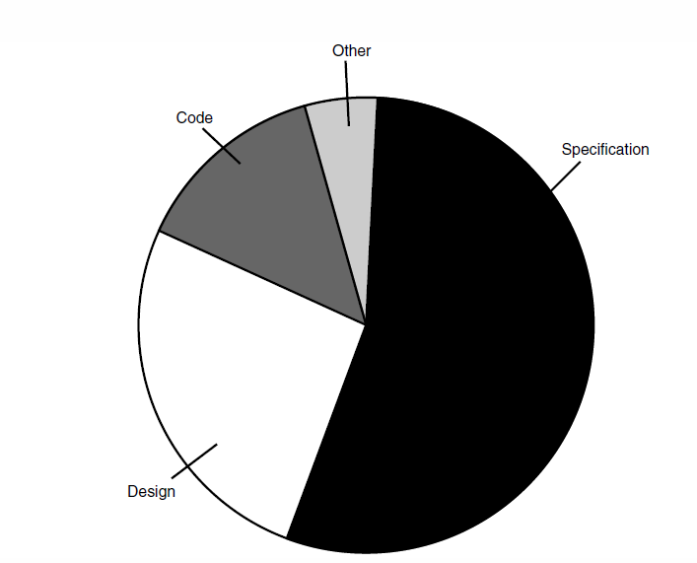
When are defects introduced?

Slide 24
Why Do Bug Occurs?
Next largest source of bug is Design.
Same reason as Specification.
Coding
Software complexity.
Poor Documentation.
Schedule pressure.
Plain dumb mistake.

Slide 25
When are defects introduced?
The majority of defects are introduced in earlier phases.
Requirements are the top factor in a project’s success or failure.
Phase | % of defects | % effort to fix
Requirements | 56 | 82
Design | 27 | 13
Code | 7 | 1
Other | 10 | 4

Slide 26
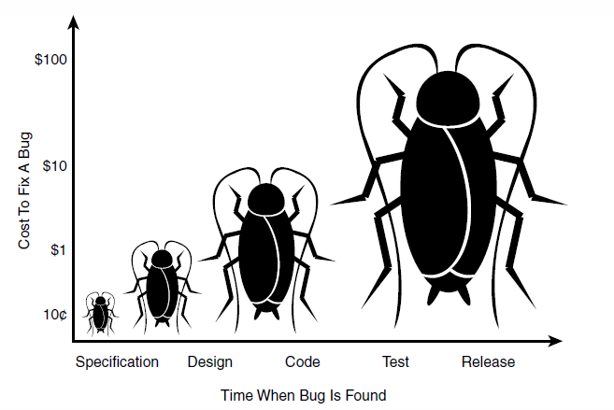
Cost of Bugs

Slide 27
Test Case
A test case is a set of conditions or variables under which a tester will determine whether a system under test satisfies requirements or works correctly.
A test case is a document, which has a set of test data (input data), preconditions, expected results and post conditions, developed for a particular test scenario in order to verify compliance against a specific requirement.

Slide 28
Test case attributes
Test case id:
Test case(unit to test):
Preconditions:
Input test data:
Priority:
Steps to be executed:
Expected result:
Actual result:
Pass/Fail:
Comments:

Slide 29
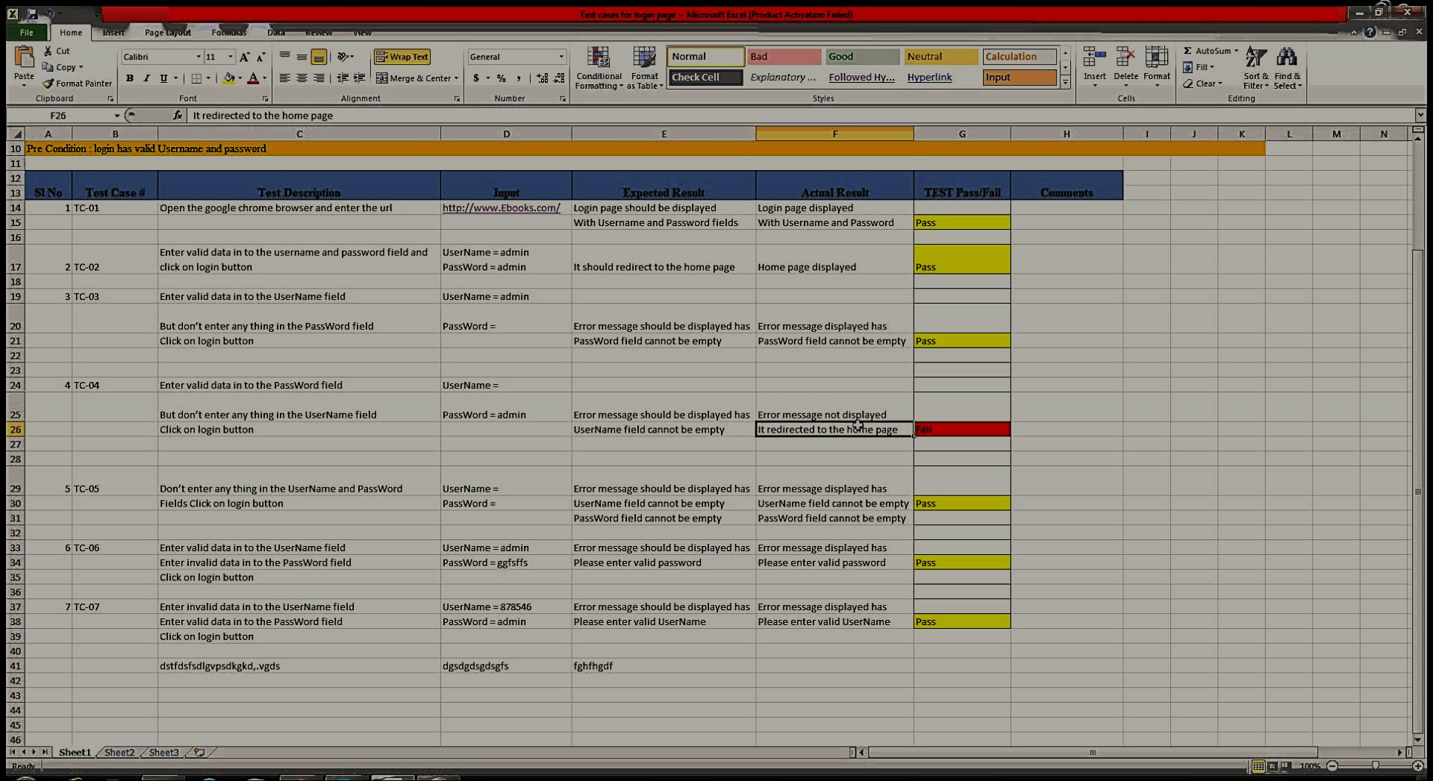

Slide 30
Software Testing terms and definition:-
Verification and Validation
Verification is the process confirming that something software meets its specification. Verification is the process of evaluating products of a development phase to find out weather they meet the specified requirements.
Verification is Static Testing.
Validation is the process confirming that it meets the user’s requirements. Validation is process of evaluating software at the end of the development process to determine whether software meets the customer expectations and requirements.
Validation is the Dynamic Testing.
Verification: Are we building the product right? Validation: Are we building the right product?

Slide 31
Verification | Validation
Verification is the process confirming that something—software—meets its specification. | Validation is the process confirming that it meets the user’s requirements.
Verification is a static practice of verifying documents, design, code and program. | Validation is a dynamic mechanism of validating & testing the actual product.
It does not involve executing the code. | It always involves executing the code.
Verification uses methods like inspections, reviews, walkthroughs, and Desk-checking etc. | Validation uses methods like black box (functional) testing, gray box testing, and white box (structural) testing etc.
It can catch errors that validation cannot catch. It is low level exercise. | It can catch errors that verification cannot catch. It is High Level Exercise.
Verification is done by development team to provide that the software is as per the specifications in the SRS. | Validation is carried out with the involvement of client and testing team.
It is human based checking of documents and files. | It is computer based execution of program.
Target is requirements specification, application and software architecture, high level, complete design, and database design etc. | Target is actual product-a unit, a module, a bent of integrated modules, and effective final product.
It generally comes first-done before validation. | It generally follows after verification.

Slide 32
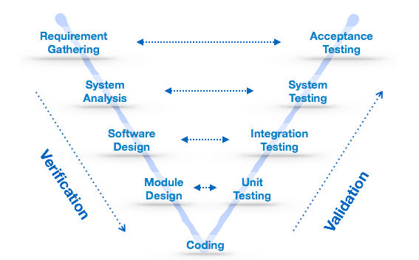
THE V-MODEL OF SOFTWARE TESTING

Slide 33
Software testing is too important to leave to the end of the project, and the V-Model of testing incorporates testing into the entire software development life cycle.
In a diagram of the V-Model, the V proceeds down and then up, from left to right depicting the basic sequence of development and testing activities.
The model highlights the existence of different levels of testing and depicts the way each relates to a different development phase.
It clearly illustrates that testing can and should start at the very beginning of the project.

Slide 34
In the requirements gathering stage the business requirements can verify and validate the business case used to justify the project. The business requirements are also used to guide the user acceptance testing.
The model illustrates how each subsequent phase should verify and validate work done in the previous phase, and how work done during development is used to guide the individual testing phases.
This interconnection lets us identify important errors, omissions, and other problems before they can do serious harm.

Slide 35
Quality Assurance and Quality Control
Software Quality Assurance:-
Means of monitoring the processes and methods used to ensure quality
SQA is a set of activities for ensuring quality in software engineering processes (that ultimately result in quality in software products). The activities establish and evaluate the processes that produce products.
Used to Develop process
Process focused
Organization wide
Relates to all products that will ever be created by a process
Increase confidence
In general, the QA activities are done before the product is manufactured or the service delivered (proactive approach).

Slide 36
Quality control
SQC is a set of activities for ensuring quality in software products. The activities focus on identifying defects in the actual products produced.
Product focused
Detection oriented
Product/project specific
Relates to specific product
The QC activities are done during the manufacturing process and once the product is manufactured.

Slide 37
Difference between Quality Assurance and Quality Control
Quality Assurance | Quality Control
Assurance: The act of giving confidence, the state of being certain or the act of making certain. | Control: An evaluation to indicate needed corrective responses; the act of guiding a process in which variability is attributable to a constant system of chance causes.
The planned and systematic activities implemented in a quality system so that quality requirements for a product or service will be fulfilled. | The observation techniques and activities used to fulfill requirements for quality.
QA defines the standards/methodology to be followed in order to meet the customer requirements. | QC ensures that the defined standards are followed at every step.
In general, the QA activities are done before the product is manufactured or the service delivered (proactive approach). | The QC activities are done during the manufacturing process and once the product is manufactured.
QA makes sure you are doing the right things, the right way. | QC makes sure the results of what you've done are what you expected.

Slide 38
Types of Testing

Slide 39
Types of Testing
Black box testing
Black box testing is the Software testing method which is used to test the software without knowing the internal structure of code or program.
It is also called as behavioral testing.
Basically software under test is called as “Black-Box”, we are treating this as black box & without checking internal structure of software we test the software.
Test cases writing involves looking at specifications.

Slide 40
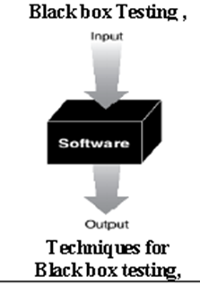
The main purpose of the Black Box is to check whether the software is working as per expected in requirement document & whether it is meeting the user expectations or not.
While testing, tester should know about the input and expected output.

Slide 41
Techniques for Black Box Testing
Boundary Value Analysis (BVA)
Equivalence Class Partitioning
Positive and negative testing
User Documentation Testing
Requirement based testing
Decision Table based testing
Graph based testing

Slide 42
Boundary Value Analysis (BVA):
Boundary value analysis is a type of black box or specification based testing technique in which tests are performed using the boundary values.
Boundary Value Analysis is the most commonly used test case design method for black box testing.
As all we know the most of errors occurs at boundary of the input values.
This is one of the techniques used to find the error in the boundaries of input values rather than the center of the input value range.

Slide 43
Input 56, 72
74 75 76
i>=75 distinction 75 wrong answer code err
59 second class 60 first 61 first
or

Slide 44
Example
Suppose we have software application which accepts the input value text box ranging from 1 to 1000, in this case we have invalid and valid inputs.
Invalid Input Valid Input Invalid Input
0 – less 1 – 1000 1001 – above
956
-21

Slide 45
Range from 1 to 1000
Min value – 1 0
Min Value 1
Min value + 1 2
Normal Value 1 – 1000
Max value – 1 999
Max value 1000
Max value +1 1001
This is testing techniques is not applicable only if input value range is not fixed

Slide 46
Equivalences Partitioning
Sometimes called equivalence classing
It is the process of methodically reducing the huge set of possible test cases into a much smaller, but still equally effective set.
or
Equivalence partitioning
also called Equivalence Class Partitioning or ECP
It is a software testing technique that divides the input data of a software unit into partitions of equivalent data from which test cases can be derived. In principle, test cases are designed to cover each partition at least once.

Slide 47
If we consider the example of windows calculator then it’s impossible to test all the cases of adding two numbers together.
Equivalence partitioning provides a systematic means for selecting the values that are important while testing and ignoring the ones that are not so important to test.
Equivalence partitioning is a black-box testing method that divides the input domain of a program into classes of data from which test cases can be derived.

Slide 48
Calculator
1digit +1 digit =100
1digit +2 digit= 910
1 digit +3 digit=9100

Slide 49
Input is either a specific numeric value, a range of values, a set of related values, or a Boolean condition.
Specific Numeric Value - one valid and two invalid equivalence classes are defined.
Example - Pune STD Code
A Valid Value - 20
Two Invalid equivalence classes: input < 20, input > 20
Range - one valid and two invalid equivalence classes are defined.
Example: Input a Month [1-12]
A valid equivalence class: Number with 1-12
Two Invalid equivalence classes: input < 1, input > 12

Slide 50
Member of a Set- one valid and one invalid equivalence class are defined.
Example – Character Digits,
Valid Set ‘0’ – ‘9’,
Invalid – Other than ‘0’ - ’9’
Boolean- one valid and one invalid class are defined.
Example- If Valid is TRUE, invalid is FALSE

Slide 51
e.g If the person is either 15 or 16 then-can apply for a learner’s license. If they are between 17 and 65 then -can apply for a full license. If they are over 65 then they can apply for a restricted license. Generate test cases using Equivalence Partitioning.
All possible equivalent classes are:
Equivalence Class | Age | Expected Outcome
EC#1 (age<15) | 14 | Not allowed to apply
EC#2 (15 <=age <17) | 16 | Learner
EC#3 (17<=age<=65) | 32 | Full
EC#4 (age>65) | 67 | Restricted
EC#5 (age < 0) | -7 | Invalid Input

Slide 52
Positive Testing (Test to Pass)
Positive Testing is testing process where the system validated against the valid input data.
Positive testing is a testing technique to show that a product or application under test does what it is supposed to do.
Positive testing verifies how the application behaves for the positive set of data.
In this testing tester always check for only valid set of values and check if a application behaves as expected with its expected inputs.
The main intention of this testing is to check whether software application not showing error when not supposed to & showing error when supposed to.

Slide 53
Such testing is to be carried out keeping positive point of view & only execute the positive scenario.
Positive Testing always tries to prove that a given product and project always meets the requirements and specifications.
Example:
An application which contains a simple textbox to enter age and requirements say that it should take only integers values.
provide only positive integer values to check whether it is working as expected.
Like 99

Slide 54
Negative testing (Test to Fail)
Negative testing is performed to ensure that the product or application under test does NOT fail when an unexpected input is given.
The purpose of Negative testing is to break the system
To verify the application response during unintentional inputs.
Negative Testing is carried out to spot the faults that can result in significant failures.
Negative Testing is performed to expose the software weakness

Slide 55
Negative testing ensures that your application can gracefully handle invalid input or unexpected user behavior.
It should show a validation error message for all invalid inputs.
Example
an application which contains a simple textbox to enter age and requirements say that it should take only integers values.
provide character values to check whether it is working as expected.
Like abc.
It should not accept and display Message as “Enter only Numbers.”

Slide 56
Both positive and negative testing is equally important for effective testing which help to improve quality of software.
Positive Testing
45 67 65 2
78
Accepted correct
Not Accepted wrong
Negative
Abc pqr s t u
Accept wrong
Not Accepted Correct

Slide 57
Requirements-based testing
Requirements-based is a testing approach in which test cases, conditions and data are derived from requirements.
It includes functional tests and also non-functional attributes such as performance, reliability or usability.

Slide 58
Stages in Requirements based Testing:
Defining Test Completion Criteria - Testing is completed only when all the functional and non-functional testing is complete.
Design Test Cases - A Test case has parameters like the initial state or precondition, the inputs, expected outcomes and actual outcomes.
Execute Tests - Execute the test cases against the system under test and document the results.
Verify Test Results - Verify if the expected and actual results match each other.
Verify Test Coverage - Verify if the tests cover both functional and non-functional aspects of the requirement.
Track and Manage Defects - Any defects detected during the testing process goes through the defect life cycle and are tracked to resolution. Defect Statistics are maintained which will give us the overall status of the project.

Slide 59
Requirements Testing process:
Testing must be carried out in a timely manner.
Testing process should add value to the software life cycle, hence it needs to be effective.
Testing the system exhaustively is impossible hence the testing process needs to be efficient as well.
Testing must provide the overall status of the project, hence it should be manageable.

Slide 60
White Box Testing
This is also known as glass box, clear box, and open box testing.
It is detailed investigation of internal logic and structure of code.
To perform white box testing tester require knowledge of the internal code and working.
In white box testing, test cases are created by looking at the code to detect any potential failure scenarios.
Tester need to look inside to check which code is not behaving properly
The suitable input data for testing various APIs and the special code paths that need to be tested by analyzing the source code for the application block.

Slide 61
Therefore, the test plans need to be updated before starting white box testing and only after a stable build of the code is available.
White box testing assumes that the tester can take a look at the code for the application block and create test cases that look for any potential failure scenarios.
During white box testing, analyze the code of the application block and prepare test cases for testing the functionality to ensure that the class is behaving in accordance with the specifications and testing for robustness.

Slide 62
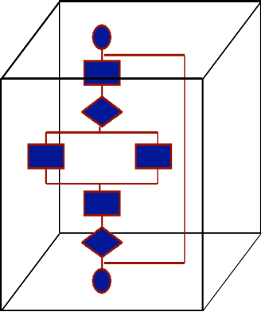
A failure of a white box test may result in a change that requires all black box testing to be repeated and white box testing paths to be reviewed and possibly changed.

Slide 63
Static Testing
Static testing refers to testing something that’s not running—examining and reviewing it.
This method involves principle of human reading the program to detect errors rather than computers.
This testing starts early in the lifecycle so it is done in verification process.
Does not involve executing the programs on computers but involves going through the code to find out whether:
The code works according functional requirement.
The code has been written in accordance with the design developed earlier in the project life cycle.
The code for any functionality has been missed out.
The code handles errors properly.

Slide 64
Static testing
Type of testing which requires only the source code of the project/software, not binaries or executables.
This testing can be done by human or with the help of specialized tools.
Advantages of Static Testing:
a) Sometimes humans can find errors that computers cannot.
b) Possibility of multiple perspectives by making multiple human read and evaluations of program.
c) Compares with specifications and standards, (in reactive testing reveals identifying symptoms rather than root cause) rather its Proactive Testing, this is done faster by human being.
d) One can find root cause for the problem.
e) Saves computer resources, as testing the code can be done before execution.

Slide 65
Static Testing Methods
Formal Review
Peer Review
Walkthrough
Inspection
Technical review

Slide 66
Documents
All types of documents can be subjected to a review
Source code
Requirements specifications
Concepts
Test plans
Test documents
Etc.

Slide 67
Formal Review
A process or meeting during which a software a product is examined by someone.
In most cases done by the team members.
Static Review provides a powerful way to improve the quality and productivity of software development to recognize and fix their own defects early in the software development process. Nowadays, all software organizations are conducting reviews in all major aspects of their work including requirements, design, implementation, testing, and maintenance.
A process or meeting during which a software product is examined by someone.
In most cases done by the team members
There are four essential elements of formal review:
Identify problem
Follow rules
Prepare
Write a report.

Slide 68
Roles and Responsibilities in a Formal Review
There are various roles and responsibilities defined for a review process.
Within a review team, four types of participants can be distinguished:
Moderator
Author
Scribe
Reviewer and
Manager.

Slide 69
Roles and Responsibilities in a Formal Review
The moderator:- The moderator (or review leader) leads the review process. His role is to determine the type of review, approach and the composition of the review team.
The moderator also schedules the meeting, disseminates documents before the meeting, coaches other team members, paces the meeting, leads possible discussions and stores the data that is collected.
The author:- As the writer of the ‘document under review’, the author’s basic goal should be to learn as much as possible with regard to improving the quality of the document.
The author’s task is to illuminate unclear areas and to understand the defects found.
.

Slide 70
3. The scribe/ recorder :- The scribe (or recorder) has to record each defect found and any suggestions or feedback given in the meeting for process improvement.
4. The reviewer:- The role of the reviewers is to check defects and further improvements in accordance to the business specifications, standards and domain knowledge.
5. The manager :- Manager is involved in the reviews as he or she decides on the execution of reviews, allocates time in project schedules and determines whether review process objectives have been met or not.

Slide 71
Inspection
Inspection is the most formal review type
It is usually led by a trained moderator (certainly not by the author).The document under inspection is prepared and checked thoroughly by the reviewers before the meeting, comparing the work product with its sources and other referenced documents, and using rules and checklists.
In the inspection meeting the defects found are logged.
Depending on the organization and the objectives of a project, inspections can be balanced to serve a number of goals.
The specific goals of a Inspection are:
• Help the author to improve the quality of the document under inspection. • Remove defects efficiently, as early as possible. • Improve product quality, by producing documents with a higher level of quality. • Create a common understanding by exchanging information among the inspection participants.

Slide 72
Walkthrough
A walkthrough is conducted by the author of the ‘document under review’
who takes the participants through the document and his or her thought processes, to achieve a common understanding and together feedback.
This is especially useful if people from outside the software discipline are present, who are not used to, or cannot easily understand software development documents.
The content of the document is explained step by step by the author, to gather information.
The participants are selected from different departments and backgrounds

Slide 73
If the audience represents a broad section of skills and disciplines, it can give assurance that no major defects are ‘missed’ in the walk-through.
A walkthrough is especially useful for higher-level documents, such as requirement specifications and architectural documents.
The specific goals of a walkthrough are:- • to present the document to stakeholders both within and outside the software discipline, in order to gather information regarding the topic under documentation. • to explain and evaluate the contents of the document. • to establish a common understanding of the document. • to examine and discuss the validity of proposed solutions and the possible alternatives.

Slide 74
Technical review
A technical review is a discussion meeting that focuses on technical content of a document.
it is led by a trained moderator, but also can be led by a technical expert.
evaluate the value of technical concepts
Compared to inspection, technical reviews are less formal
The experts that are needed to be present for a technical review can be architects, chief designers and key users.
It is often performed as a peer review without management participation.
The specific goals of a technical review are: • evaluate the value of technical concepts and alternatives in the product and project environment. • establish consistency in the use and representation of technical concepts. • ensuring at an early stage, that technical concepts are used correctly; • inform participants of the technical content of the document.

Slide 75
Structural testing
Structural testing, also known as glass box testing or white box testing is an approach where the tests are derived from the knowledge of the software's structure or internal implementation. The other names of structural testing includes clear box testing, open box testing, logic driven testing or path driven testing. During structural testing the tester is concentrating on how the software does it.
For example, a structural technique wants to know how loops in the software are working. Different test cases may be derived to exercise the loop once, twice, and many times. This may be done regardless of the functionality of the software.
Structural testing can be used at all levels of testing.

Slide 76
Code functional testing
In functional testing basically the testing of the functions of component or system is done.
It refers to activities that verify a specific action or function of the code.
Sort of debugging
Require knowledge of loop iterations, conditions, input, output.
Being developer we know obvious errors for some input , so we perform test by giving inputs and checking output, to highlight obvious mistakes.
Check complex logic and conditions, check the working loops and iterations by simply putting printf statement
Functional test tends to answer the questions like “does this particular feature work”. This is typically described in a requirements specification or in a functional specification.

Slide 77
Code Coverage testing
It inspect the code directly
Code Coverage testing is determining how much code is being tested. It can be calculated using the formula:
Code Coverage = (Number of lines of code exercised)/(Total Number of lines of code) * 100%
In computer science, code coverage is a measure used to describe the degree to which the source code of a program is tested by a particular test suite.
A program with high code coverage has been more thoroughly tested and has a lower chance of containing software bugs than a program with low code coverage.
In this you must enter and exit every module of code.
It is type of feedback loop where it execute every line of code ,follow each and every logic and decision path through the software product.
Examine the product at this level is called code coverage analysis.
It is dynamic white box testing.

Slide 78
Following are the types of code coverage Analysis:
Statement coverage and Block coverage
Function coverage
Function call coverage
Branch coverage
Modified condition/decision coverage
Code Coverage= 900/1000*100= 90%
500/1000=50%

Slide 79
statement coverage/Line Coverage
The statement coverage is also known as line coverage.
It verifies what the written code is expected to do and not to do
It measures the quality of code written
It checks the flow of different paths in the program and it also ensure that whether those path are tested or not.

Slide 80

The statement coverage can be calculated as shown below:

Slide 81
source code complexity
Cyclomatic complexity is a software metric (measurement), used to indicate the complexity of a program. It is a quantitative measure of the number of linearly independent paths through a program's source code.
or
Cyclomatic complexity is a source code complexity measurement that is being correlated to a number of coding errors. It is calculated by developing a Control Flow Graph of the code that measures the number of linearly-independent paths through a program module.

Slide 82
It is observed that complex code is difficult to maintain.
It introduce new /complex defects in the program.

Slide 83
Role of Testing
Reduce the risk of problems
Reduce long-term defect-related costs
Contribute to the quality of the software
Help meeting standards:
Contractual or legal requirements
Industry-specific standards
Testing can give confidence in the quality of the software if it finds few or no defects
If defects are found, the quality increases when those defects are fixed
Lessons learnt from previous mistakes improve future performance

Slide 84
Why Do Bug Occurs?
Number one cause of software bug is Specification.
Spec. Simply isn’t written.
It’s Constantly changing nature.
Not communicated to entire development team.
Planning.

Slide 85
Why Do Bug Occurs?
Next largest source of bug is Design.
Same reason as Specification.
Coding
Software complexity.
Poor Documentation.
Schedule pressure.
Plain dumb mistake.

Slide 86
Skills of SW Tester
Explorer: Don’t afraid of getting into unknown situation.
Troubleshooter: Figuring out why something doesn`t work
Relentlessness: They keep on trying. Try everyway possible.
Creative: Creative thinking. Not only testing but have to think about all the points.
Perfectionist: Refer Perfection in any case.
Good Judgment: Decision making of when to start when to stop etc.
Tactful & Diplomatic: Tester should be tactful and diplomat to convey their message to programmer about the their fault\Bug.
Persuasive: Need to be good to make their point clear to programmer/developer.

Slide 87
Skills of SW Tester
Communication Skills:- Must have strong verbal and written skills. To be Good listener
Domain Knowledge:- Detailed Knowledge about the Software or application to help them to find errors.
Desire to learn:- Ready to learn latest technologies, tools etc.
Technical skills:- Good Software tester must have Strong technical skills like MS office ,Testing Tools etc.
Think from users perspective:- Software is developed for customers, and customers may not having all technical skills. If tester fail to keep in mind then he can miss many important bugs.

